Slide 1
BITS Pilani presentation
K.Anantharaman
kanantharaman@wilp.bits-pilani.ac.in
2-9/3/24
SE ZG544 S2-23-24 Agile SW Process

Slide 2
Module-6 Agile Planning & Release Planning
2-9/3/24
SE ZG544 S2-23-24 Agile SW Process

Slide 3
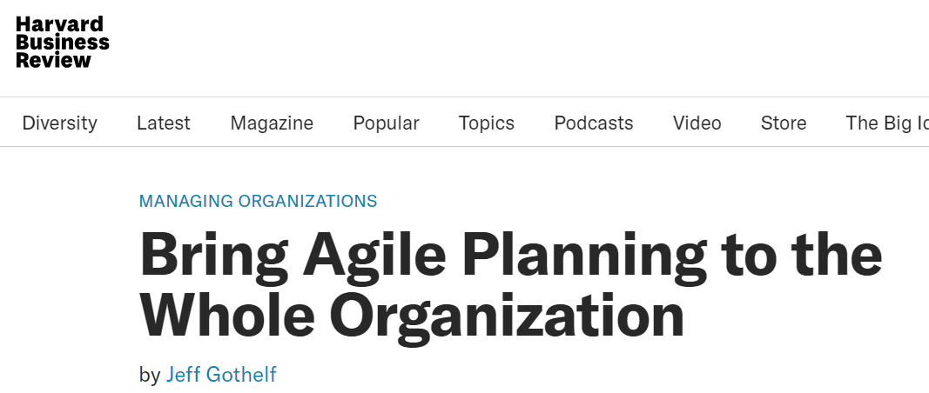
Agile Planning
https://hbr.org/webinar/2015/05/bring-agile-planning-to-the-whole-organization
2-9/3/24
SE ZG544 S2-23-24 Agile SW Process

Slide 4
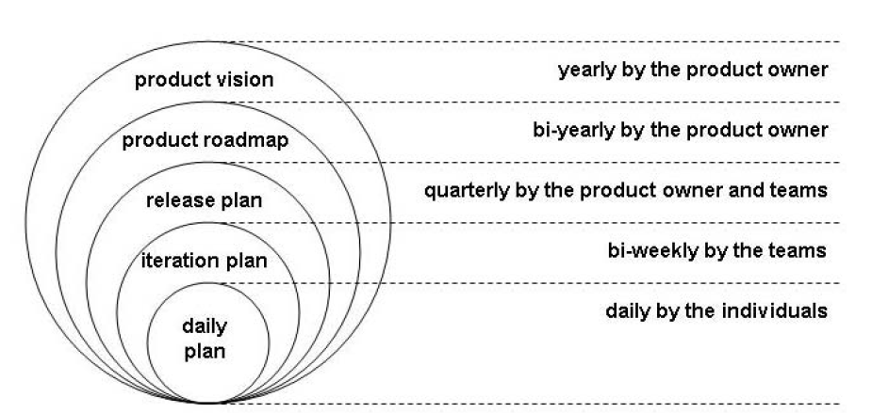
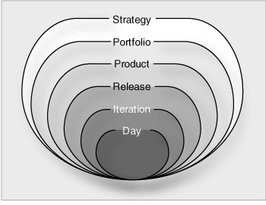
Agile Planning
Single Product Organization
Many Products or Services Organization
An Enterprise Agile Framework
Ref: 5 Levels of Agile Planning: From Enterprise Product Vision to Team Stand-up by Hubert Smits
2-9/3/24
SE ZG544 S2-23-24 Agile SW Process

Slide 5
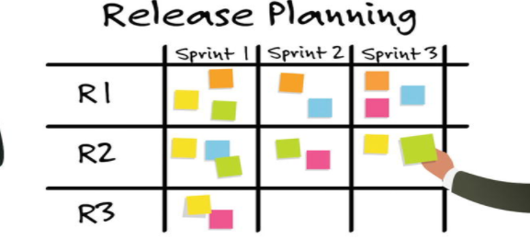
Release Planning
Inputs:
Product Vision
Product Road Map
Product Backlog
Release Backlog, Velocity, Iteration length, Trade off-matrix (Scope, Cost, Schedule)
2-9/3/24
SE ZG544 S2-23-24 Agile SW Process

Slide 6
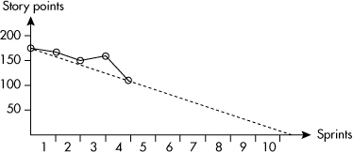
Example: Release planning
Inputs:
Release backlog - 50 User stories
(200 Story points)
Velocity = 20 Story points
Iteration Length - 2 weeks
Budget = $200,000
Cost of each Iteration = $20000
Trade of Matrix :
Schedule (Fixed), Cost(Fixed), Scope(Flexible)
Outputs:
Total number of Iterations required = 10 Iterations (200/20)
If you are planning for 2 releases
Number of iterations per release = 5 Iterations
Duration of each release = 5*2 = 10 weeks
Suppose, Iteration cost = $25000; only 8 iterations is possible.
160 points can be delivered ( Scope may have to be reduced)
Release progress tracking
Release Burndown Chart
2-9/3/24
SE ZG544 S2-23-24 Agile SW Process
Source: Agile Estimation and Planning by Mike Cohen

Slide 7
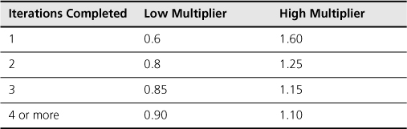
Estimating Velocity
Use historical values.
Run an iteration
Make a forecast.
You should consider expressing the estimate as a range.
Example: If your team velocity is 20 story points - You have a very limited chance of being correct in future. Instead give a range 15-24 story points
2-9/3/24
SE ZG544 S2-23-24 Agile SW Process
Source: Agile Estimation and Planning by Mike Cohen
Source: Agile Estimation and Planning by Mike Cohen

Slide 8
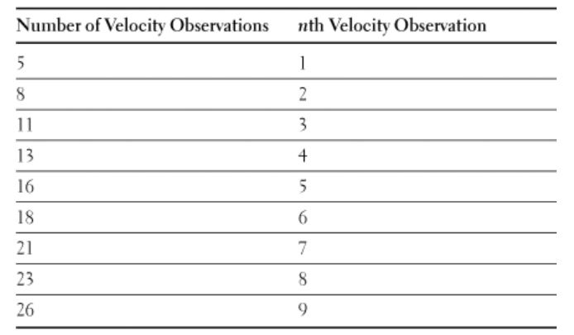
High-confidence forecast- Example
16
20 20 25 26 26 26 28
Velocity of completed 8 sprints
:20, 25, 28, 26, 16, 20, 26, 26
90% Confidence Interval
Sorted Velocity List
20 ➔ Lower confidence, certainly we will do
23 ➔ Mean Velocity – We will get here
26 ➔ Upper confidence, Most we could expect
Use the nth Lowest and the nth Highest Observation of a Sorted List of Velocities to Find a 90% Confidence Interval
Source: Succeeding with Agile SW development by Mike Cohen
2-9/3/24
SE ZG544 S2-23-24 Agile SW Process

Slide 9
Creating a Release Plan Exercise
The backlog for this release has 140 story points, with a start date of D0 and a sprint length of 2 weeks. Range of estimated velocities: Low = 18; High = 20
The average velocity of the first two sprints was measured to be 15 Story Points.
1. Calculate the maximum and minimum schedules, as well as the points that can be completed per sprint, by maintaining the same velocity range.
2. What is the maximum and minimum timeline and number of points that can be completed if the budget is $140000 and the cost of a sprint is $20000?
2-9/3/24
SE ZG544 S2-23-24 Agile SW Process

Slide 10
Creating a Release Plan Exercise
1. Calculate the maximum and minimum schedules, as well as the points that can be completed per sprint, by maintaining the same velocity range.
Velocity High =20; Number of Iteration Required = 140/20 = 7
Number of Story points completed in first two sprints= 30
Remaining Story points = 110
Number of iteration required to complete the 110 points = 110/20 = 5.5 ~ 6 Sprints
Sprint 1-2 = 15 points; Sprint 3-7 = 20; Total number of points that ca be delivered = 130
Velocity low = 18; Number of Iteration Required = 140/18 ~ 8 Sprints
Number of Story points completed in first two sprints= 30
Remaining Story points = 110
Number of iteration required to complete the 110 points = 110/18 = 6.1 ~ 7 Sprints
Sprint 1-2 = 15 points; Sprint 3-7 = 18; Total number of points that ca be delivered = 120
2-9/3/24
SE ZG544 S2-23-24 Agile SW Process

Slide 11
Creating a Release Plan Exercise
2. What is the maximum and minimum timeline and number of points that can be completed if the budget is $140000 and the cost of a sprint is $20000?
Available budget is $140000, Each Iteration cost = $20000; Only 7 Iterations is possible.
Max and Min Schedule is same = D0 +14 Weeks
Velocity High =20; Number of Iteration Required = 140/20 = 7
Number of Story points completed in first two sprints= 30
Remaining Story points = 110
Number of iteration required to complete the 110 points = 110/20 ~6
Sprint 1-2 = 15 points; Sprint 3-7 = 20 points ;
Total number points that can be delivered = 130 points
Velocity low = 18; Number of Iteration Required = 140/18 ~ 8 Sprints
Number of Story points completed in first two sprints= 30
Remaining Story points = 110
Number of iteration required to complete the 110 points = 110/18 ~ 7
Max Schedule = D0+ 14 weeks
2-9/3/24
SE ZG544 S2-23-24 Agile SW Process

Slide 12
Module-6 Agile Planning & Release Planning – Additional Notes
2-9/3/24
SE ZG544 S2-23-24 Agile SW Process

Slide 13
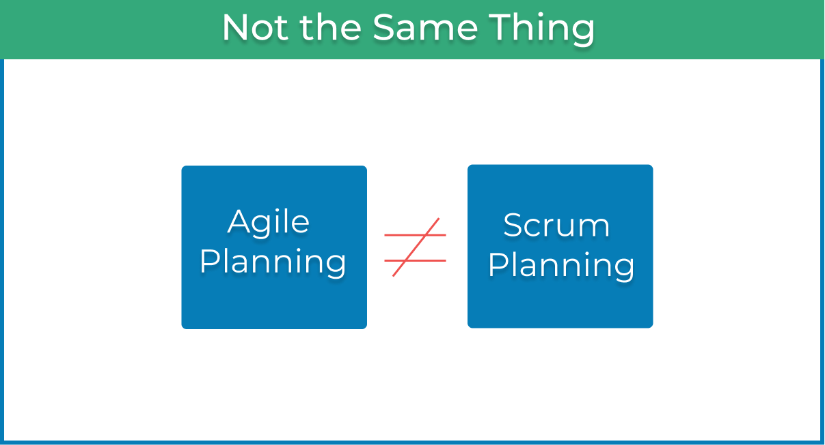
Agile Planning
Agile thinking applied across various industries and not just software.
It is more important to know how to apply generic techniques and practices on the global company level, irrespective of the type of business.
Source : https://kanbanize.com/agile/project-management/planning
2-9/3/24
SE ZG544 S2-23-24 Agile SW Process

Slide 14
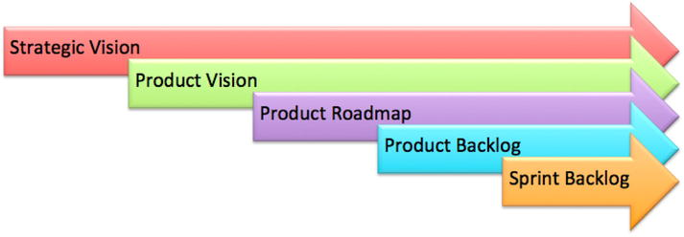
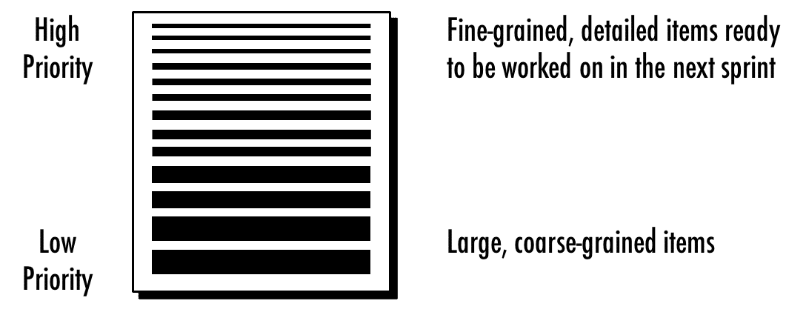
5-Levels of Agile Planning
(Product Planning)
Flexibility to accommodate change
Decreases
DEEP:
Detailed, Emergent,
Estimable
Prioritized
An Enterprise Agile Framework
Ref: 5 Levels of Agile Planning: From Enterprise Product Vision to Team Stand-up by Hubert Smits
2-9/3/24
SE ZG544 S2-23-24 Agile SW Process

Slide 15
5-Levels of Agile Planning
(Product Planning)
Each of the five levels of planning addresses the fundamental planning principles: priorities, estimates and commitments.
5 Levels of Agile Planning is aimed to avoid big upfront design
Most agile teams are concerned only with the three innermost levels (Day, Iteration, Release) of the planning onion.
Involve stakeholders in planning, Review the plans frequently
5 Levels of Agile Planning: From Enterprise Product Vision to Team Stand-up by Hubert Smits
2-9/3/24
SE ZG544 S2-23-24 Agile SW Process

Slide 16
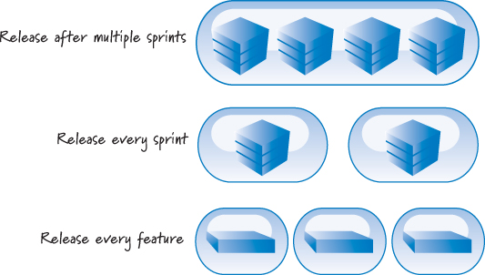
Patterns of Release Planning/Different release cadences
Many organizations have its own cadence regarding release of products to its customers.
Continuous deployment
(or Continuous delivery)
Whichever release cadence being followed, Most organizations find some amount of longer-term, higher-level planning to be useful. We refer to this type of planning as release planning
Ref: Essential Scrum: A Practical Guide to the Most Popular Agile Process by Kenneth S. Rubin Published by Addison-Wesley Professional, 2012
2-9/3/24
SE ZG544 S2-23-24 Agile SW Process

Slide 17
Agile Release Planning
Release planning is an important task for product people working with agile teams:
It ensures that the product is moving in the right direction and it connects Product strategy and tactics.
Release as a version of a product:
For example, Mac OS X Catalina and Windows 10.
Releases come in two flavors: major releases, like iOS 13, and minor releases, such as iOS 13.3.
Release planning is the process of determining the desired outcome of one or more major releases and maximizing the chances of achieving it.
Source: https://www.romanpichler.com/blog/release-planning-advice/
2-9/3/24
SE ZG544 S2-23-24 Agile SW Process

Slide 18
Agile Release Planning …
Agile release planning provides a high-level summary timeline of the release schedule (typically 3 to 6 months).
Agile release planning also determines the number of iterations or sprints in the release.
Allows the product owner and team to decide how much needs to be developed and how long it will take to have a releasable product based on business goals, dependencies, and impediments.
Source: https://www.romanpichler.com/blog/release-planning-advice/
2-9/3/24
SE ZG544 S2-23-24 Agile SW Process

Slide 19
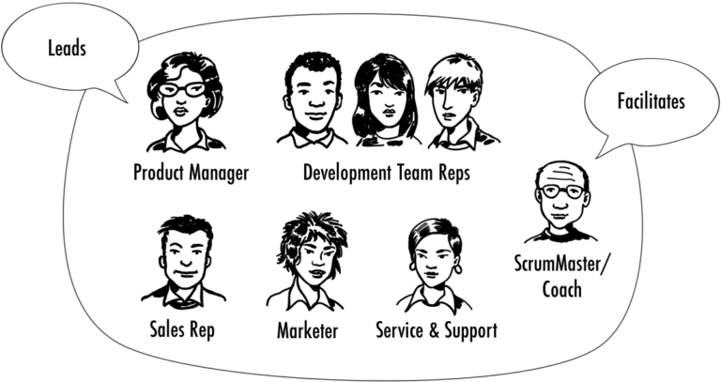
Make Release Planning Collaborative
Release planning is best done as a collaborative effort by involving the stakeholders and the development team
Schedule regular roadmapping sessions.
Possibly as part of your strategy review process and invite key stakeholders and development team members.
Discuss Release Progress
Invite Stakeholders to Sprint Review meetings.
Source: https://www.romanpichler.com/blog/release-planning-advice/
2-9/3/24
SE ZG544 S2-23-24 Agile SW Process

Slide 20
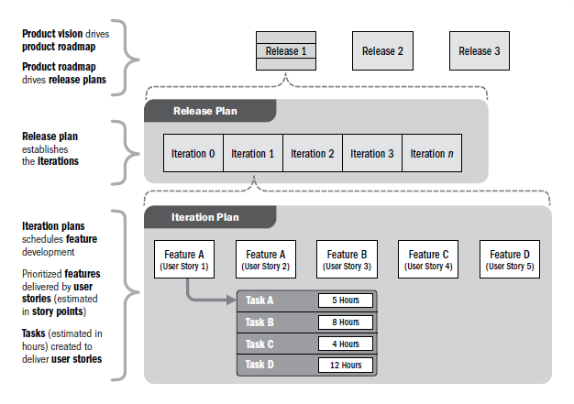
Relationship between product vision, product roadmap, release planning, and iteration planning.
Source: PMI.ORG
2-9/3/24
SE ZG544 S2-23-24 Agile SW Process

Slide 21
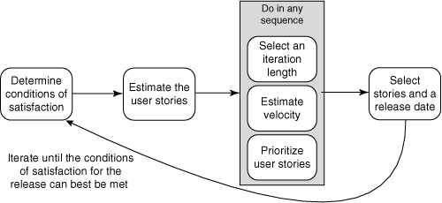
The steps in planning a release.
Product Vision, Product Roadmap
5
3
Monitoring progress
Of the Release
Product Backlog
4
1
2
Use Trade-off Matrix (Fixed, Flexible, Accept), Date, Scope, Cost - Fix important factor
Given a fixed schedule, we will choose a level of resources and adjust the features set as necessary.
1
2-9/3/24
SE ZG544 S2-23-24 Agile SW Process
Source: Agile Estimation and Planning by Mike Cohen

Slide 22
Development Constraint Combinations
Project Type | Scope | Date | Cost
Fixed Everything (Not Recommended) | Fixed | Fixed | Fixed
Fixed Scope and Date (Not Recommended) | Fixed | Fixed | Flexible/Accept
Fixed Scope | Fixed | Flexible | Fixed/Flexible
Fixed Date | Flexible | Fixed | Fixed
Ref: Agile Estimating and Planning by Mike Cohn Published by Addison-Wesley Professional, 20
2-9/3/24
SE ZG544 S2-23-24 Agile SW Process

Slide 23
Condition of satisfaction
Establishing clear, specific, and measurable goals. Call these goals product or release goals - captured in product roadmap.
Prioritize the Success Factors for Releases:
But in reality, unforeseen things do happen. The development progress may not be as fast as anticipated, for instance, or one of the technologies may not work as expected.
Use Trade-off Matrix (Fixed, Flexible, Accept)
Date, Scope, Cost - Fix important factor
Quality: Quality should be fixed and not be compromised. Otherwise, responding to user feedback and changing market conditions and quickly adapting your product will be hard, if not impossible.
Ref: Agile Estimating and Planning by Mike Cohn Published by Addison-Wesley Professional, 20
2-9/3/24
SE ZG544 S2-23-24 Agile SW Process

Slide 24
Estimate User Stories
It is not necessary to estimate everything that a product owner may ever want.
It is necessary only to have an estimate for each new feature that has some reasonable possibility of being selected for inclusion in the upcoming release.
Often, a product owner will have a wish list that extends two, three, or more releases into the future. It is not necessary to have estimates on the more distant work.
Ref: Agile Estimating and Planning by Mike Cohn Published by Addison-Wesley Professional, 20
2-9/3/24
SE ZG544 S2-23-24 Agile SW Process

Slide 25
Factors in
Select an Iteration Length
• The length of the release being worked on
• The amount of uncertainty
• The ease of getting feedback
• How long priorities can remain unchanged
• Willingness to go without outside feedback
• The overhead of iterating
• How soon a feeling of urgency is established
Make a Decision and stick to the Rhythm
2 weeks sprint is ideal.
Ref: Agile Estimating and Planning by Mike Cohn Published by Addison-Wesley Professional, 20
2-9/3/24
SE ZG544 S2-23-24 Agile SW Process

Slide 26
The Overall Length of the Release
Short projects benefit from short iterations.
The length of a project’s iterations determines:
How often the software can be shown and progress measured?
How often the product owner and team can refine their course, because priorities and plans are adjusted between iterations.
Opportunities to gather end-of-iteration feedback
General rule of thump: Aim for five to six feedback opportunities per release.
Example: 3 months release
Iteration length : 2 weeks – 5 times feedback for course corrections-ok
4 weeks iteration provides only two times feedback- not ok
Ref: Agile Estimating and Planning by Mike Cohn Published by Addison-Wesley Professional, 20
2-9/3/24
SE ZG544 S2-23-24 Agile SW Process

Slide 27
The Amount of Uncertainty
Uncertainty comes in multiple forms.
User need
Technical aspects
Team Velocity
The more uncertainty of any type there is, the shorter the iterations should be.
Shorter terations allow more frequent opportunities for the team to measure its progress through its velocity and more opportunities to get feedback from stakeholders, customers, and users.
Ref: Agile Estimating and Planning by Mike Cohn Published by Addison-Wesley Professional, 20
2-9/3/24
SE ZG544 S2-23-24 Agile SW Process

Slide 28
The ease of getting feedback
Choose your iteration length to maximize the value of the feedback that can be received from those inside and outside the organization.
Ref: Agile Estimating and Planning by Mike Cohn Published by Addison-Wesley Professional, 20
2-9/3/24
SE ZG544 S2-23-24 Agile SW Process

Slide 29
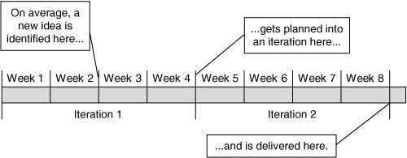
How Long Priorities Can Remain Unchanged
Once a development team commits to completing a specific set of features in an iteration, it is important that that the product owner not change priorities during the iteration, also protect the team from others to change the priorities.
It takes an average of 1½ iterations to go from idea to software.
Ref: Agile Estimating and Planning by Mike Cohn Published by Addison-Wesley Professional, 20
2-9/3/24
SE ZG544 S2-23-24 Agile SW Process

Slide 30
Willingness to Go without Outside Feedback
Even with a well-intentioned and highly communicative team, it is possible that the results of an iteration could be found worthless when shown to the broader organization or external users at the conclusion of the iteration.
This may happen if the developers misunderstand the product owner (and don’t communicate often enough during the iteration).
It could also happen if the product owner misunderstands the needs of the market or users.
Less often a team receives outside feedback, the more likely we are to go astray and the greater the loss will be when that happens.
Ref: Agile Estimating and Planning by Mike Cohn Published by Addison-Wesley Professional, 20
2-9/3/24
SE ZG544 S2-23-24 Agile SW Process

Slide 31
The Overhead of Iterating
There are costs associated with each iteration.
For example, each iteration must be fully regression tested:
If this is costly (usually in terms of time), the team may prefer longer, four-week iterations.
Naturally, one of the goals of a successful agile team is to reduce (or nearly eliminate) the overhead associated with each iteration.
But especially during a team’s early iterations, this cost can be significant and will influence the decision about the best iteration length.
Ref: Agile Estimating and Planning by Mike Cohn Published by Addison-Wesley Professional, 20
2-9/3/24
SE ZG544 S2-23-24 Agile SW Process

Slide 32
How Soon a Feeling of Urgency Is Established
“As long as the end date of a project is far in the future, we don’t feel any pressure and work leisurely. When the pressure of the finish date becomes tangible, we start working harder.” - Niels Malotaux (2004).
Even with four-week iterations , it is sufficiently far away that many teams will feel tangibly less stress during their first week than during the fourth and final week of an iteration.
The point is not to put the team under more pressure but distribute it more evenly across a suitably long iteration.
Ref: Agile Estimating and Planning by Mike Cohn Published by Addison-Wesley Professional, 20
2-9/3/24
SE ZG544 S2-23-24 Agile SW Process

Slide 33
Stick with It to Achieve a Steady Rhythm
Whatever duration you choose, you are better off choosing a duration and sticking with it rather than changing it frequently.
Teams fall into a natural rhythm when using an unchanging iteration duration.
A regular iteration rhythm acts like a heartbeat for the project.
“Rhythem is a significant factor that helps achieve a sustained pace”
Ref: Agile Estimating and Planning by Mike Cohn Published by Addison-Wesley Professional, 20
2-9/3/24
SE ZG544 S2-23-24 Agile SW Process

Slide 34
Making a Decision
One of the main goals in selecting an iteration length is finding one that encourages everyone to work at a consistent pace throughout the iteration.
If the duration is too long, there is a natural tendency to relax a bit at the start of the iteration, which leads to panic and longer hours at the end of the iteration. Strive to find an interation duration that smooths out these variations.
Two-week iterations to be ideal.
Mike Cohen suggests:
To follow a macro-cycle of six two-week iterations followed by a one-week iteration. “6 × 2 + 1.”
During the one-week iteration, however, the team chooses its own work.
Ref: Agile Estimating and Planning by Mike Cohn Published by Addison-Wesley Professional, 20
2-9/3/24
SE ZG544 S2-23-24 Agile SW Process

Slide 35
Estimating Velocity
It is better to be roughly right than precisely wrong.”—John Maynard Keynes.
One of the challenges of planning a release is estimating the velocity of the team. You have the following three options:
Use historical values.
Run an iteration
Make a forecast.
You should consider expressing the estimate as a range.
You could create a range by simply adding and subtracting a few points to the average or by looking at the team’s best and worst iterations over the past two or three months.
Example: If your team velocity is 20 story points - You have a very limited chance of being correct in future. Instead give a range 15-24 story points.
Ref: Agile Estimating and Planning by Mike Cohn Published by Addison-Wesley Professional, 20
2-9/3/24
SE ZG544 S2-23-24 Agile SW Process

Slide 36
Using Historical values
Use historical values only when very little has changed between the old project and team and the new project and team.
Before using them, ask yourself questions like these:
Is the technology the same?
Is the domain the same?
Is the team the same?
Is the product owner the same?
Are the tools the same?
Is the working environment the same?• Were the estimates made by the same people?
The answer to each question is often yes when the team is moving onto a new release of a product they just worked on. In that case, using the team’s historical values is entirely appropriate. Even though velocity in a situation like this is relatively stable, you should still consider expressing it as a range.
Ref: Agile Estimating and Planning by Mike Cohn Published by Addison-Wesley Professional, 20
2-9/3/24
SE ZG544 S2-23-24 Agile SW Process

Slide 37
Run an Iteration
An ideal way to forecast velocity is to run an iteration (or two or three) and then estimate velocity from the observed velocity during the one to three iterations.
Because the best way to predict velocity is to observe velocity, this should always be your default approach.
Multipliers for Estimating Velocity Based on Number of Iterations Completed
Ref: Agile Estimating and Planning by Mike Cohn Published by Addison-Wesley Professional, 20
2-9/3/24
SE ZG544 S2-23-24 Agile SW Process

Slide 38
Forecasting Velocity
Estimate the number of hours that each person will be available to work on the project each day.
2. Determine the total number of hours that will be spent on the project during the iteration.
3. Arbitrarily and somewhat randomly select stories, and expand them into their constituent tasks.
Repeat until you have identified enough tasks to fill the number of hours in the iteration.4. Convert the velocity determined in the preceding step into a range.
Ref: Agile Estimating and Planning by Mike Cohn Published by Addison-Wesley Professional, 20
2-9/3/24
SE ZG544 S2-23-24 Agile SW Process

Slide 39
Example
Number of Team members | Available hours per day/team member | Total Available hrs | Team Capacity for 10 days iteration
4 | 6 hrs. | 4*6= 24 | 10*24=240
Product Backlog
As a Cab Driver, I Want to ...... | 3
As a Cab Driver, I Want to ...... | 5
As a Cab Driver, I Want to ...... | 5
As a Cab Driver, I Want to ...... | 2
As a Cab Driver, I Want to ...... | 5
Sprint Backlog
Code the UI | 10
Write Tests | 8
Write DB Stored Procedure | 12
Automate Tests | 10
40hrs
60hrs
60hrs
22hrs
60hrs
Velocity = 3+5+5+2+5=20 Story Points
Ref: Agile Estimating and Planning by Mike Cohn Published by Addison-Wesley Professional, 20
2-9/3/24
SE ZG544 S2-23-24 Agile SW Process

Slide 40
High-confidence forecast- Example
Suppose we want to create high confidence forecast(90%) for the next release.
As soon as the team has run five or more sprints, we can create a high-confidence forecast
Suppose, Velocity of completed 8 sprints:20, 25, 28, 26, 16, 20, 26, 26.
Sorted list:16, 20, 20, 25, 26, 26, 26, 28
Ref: Agile Estimating and Planning by Mike Cohn Published by Addison-Wesley Professional, 20
2-9/3/24
SE ZG544 S2-23-24 Agile SW Process

Slide 41
Use the nth Lowest and the nth Highest Observation of a Sorted List of Velocities to Find a 90% Confidence Interval
Velocity of completed 8 sprints
:20, 25, 28, 26, 16, 20, 26, 26
Sorted Velocity List
16
20 20 25 26 26 26 28
90% Confidence Interval
20 ➔ Lower confidence, certainly we will do
23 ➔ Mean Velocity – We will get here
26 ➔ Upper confidence, Most we could expect
Source: Succeeding with Agile SW development by Mike Cohen
Ref: Agile Estimating and Planning by Mike Cohn Published by Addison-Wesley Professional, 20
2-9/3/24
SE ZG544 S2-23-24 Agile SW Process

Slide 42
Creation a Release Plan
Total story points of Release backlog divided by Mean velocity or Velocity range.
This will give us a provisional number of sprints required for the release
Example:
Total Story points = 200; Mean velocity = 20;Number Sprints required = 10
We then map the identified number of sprints onto the calendar and consider the factors that are likely to influence the velocity and that are not accounted for in the velocity forecast.
These can include holidays, vacations, training and development, sickness statistics, and planned changes to the project organization, such as modifying the team composition. We adjust the forecasted velocity of each sprint accordingly.
Ref: Agile Estimating and Planning by Mike Cohn Published by Addison-Wesley Professional, 20
2-9/3/24
SE ZG544 S2-23-24 Agile SW Process

Slide 43
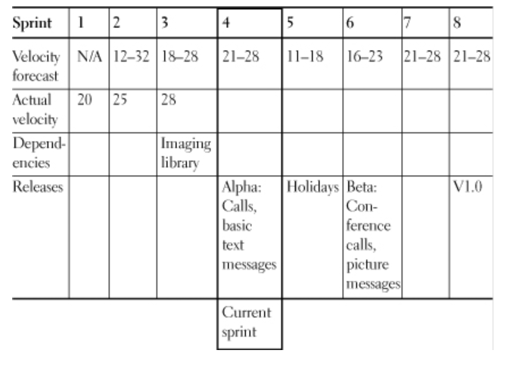
Sample Release Plan
Actual velocity for the first three sprints of 20, 25, and 28.
The average (mean) velocity per sprint, then, is 24 points.
The Scrum team has forecasted a velocity of 21 to 28 points for the fourth, seventh, and eighth sprints using the multipliers Table(below).
The release plan also anticipates a velocity drop in sprints five and six, when several team members will take time off and then return to work.
Source: Agile Estimation and Planning by Mike Cohen
2-9/3/24
SE ZG544 S2-23-24 Agile SW Process

Slide 44
Tracking the Progress of the Release – Release Burndown chart
X-Axis - Number of sprints as the unit
Y- Axis - Number of story points estimated
The first data point is the estimated effort of the entire product backlog before any development has taken place.
To arrive at our next data point, we determine the remaining effort in the product backlog at the end of the first sprint.
Then we draw a line through the two points. This line is called the burndown(…. Line)
It shows the rate at which the effort in the product backlog is consumed.
If we extend the burndown line to the x-axis, we can forecast when the project is likely to finish—assuming effort and velocity stay stable.
The solid line is the actual burndown- Indicate the progress
Slow start. Might be - impediments and risks materializing, team-building dynamics, or technology issues.
Third sprint, the remaining effort even increased. - caused by the team reestimating backlog items or discovering new requirements
The fourth sprint saw a steep burndown; the project progressed fast.
2-9/3/24
SE ZG544 S2-23-24 Agile SW Process

Slide 45
Product Visioning - Level 1
A product vision describes the future state of a product (Big Picture) that a company or team desires to achieve. You can also define that future state as: a goal.
Aligns:
Product strategy, product development roadmap, backlog & planning, execution & product launch
There is/can be a difference between a product and company vision.
What information does a product vision contain?
Focused on Customers (B2C or B2B)- How it will benefit the company and the customer.(What?)
It’s looking into the future and outlining a clear state of the product/goal that the company and team(s) want to achieve. This goal should be underlined with the motivation behind it (Why?, not How?)
The art of defining a great product vision that people want to follow is to make it catchy.
Source:https://www.christianstrunk.com/blog/product-vision
2-9/3/24
SE ZG544 S2-23-24 Agile SW Process

Slide 46
A. How to define a product vision?
Defining key product information.
Have some valid data in the product discovery process to find answers to open questions.
Gaining a clear picture of your customer, your market, the problems you want to solve, and your business goals
According to Roman Pichler’s product vision board, it’s important to answer 4 key questions:
What’s the target group?, What are the customer needs?, What is and will be the product and it’s USP(s)?,What are the business goals?
Phrasing the product vision in one inspiring sentence.
Examples: Google’s companies vision statement is: “to provide access to the world's information in one click.” because that’s Google’s core business.
Card reader Makers: “We believe in a world where small businesses can offer a super fast and safe payment experience to their customers, for minimal costs with no administrative efforts.“
3. Why is having a product vision important? – Gives direction to Teams
Who owns? What is the Process to create product vision?
2-9/3/24
SE ZG544 S2-23-24 Agile SW Process

Slide 47
B. How to define a product vision?- Classical format.
Create an elevator statement or a Product vision box/Product Vision Board . (Non technical)
A format popularized by Geoffrey Moore’s classic Crossing the Chasm
For (target customer) who (statement of need or opportunity), the (product name) is a (product category) that (key benefit, reason to buy).
Unlike (primary competitive alternative), our product (statement of primary differentiation).
Here’s an example of a product vision statement for Microsoft Surface:
For the business user who needs to be productive in the office and on the go, the Surface is a convertible tablet that is easy to carry and gives you full computing productivity no matter where you are.
Unlike laptops, Surface serves your on-the-go needs without having to
carry an extra device.
Any further planning (Design) at this stage may divert our attention from future vision of the product.
Source:280 Group LLC
2-9/3/24
SE ZG544 S2-23-24 Agile SW Process

Slide 48
Product Roadmap – Level 2 Planning
A product vision is a high-level aspirational projection of the future state of a product.
It must be impactful to generate sufficient interest among the innovators, early adopters, and early-stage investors.
A product roadmap is essentially a timeline of feature rollout plans.- (Review the roadmap regularly)
It helps product managers prioritize R&D dollars to maximize chances of realizing the product’s promised or anticipated ROI.
It allows the product team to focus on more value-creating features “here and now” versus hundreds of features that might have limited relative potential.
It helps customers know that their favorite features are planned somewhere down the road, and, if they so desire, the product team can expedite them.
it also allows customer feedback of what features are perceived as critical and what could be deferred to another time.
Helps the delivery team to see as whole, learn business priorities, Provide technical and estimates inputs to Product roadmap.
2-9/3/24
SE ZG544 S2-23-24 Agile SW Process

Slide 49
Type of Product Roadmaps
Goal/Objectives driven roadmap
Feature Driven
Date/Time Driven
2-9/3/24
SE ZG544 S2-23-24 Agile SW Process

Slide 50
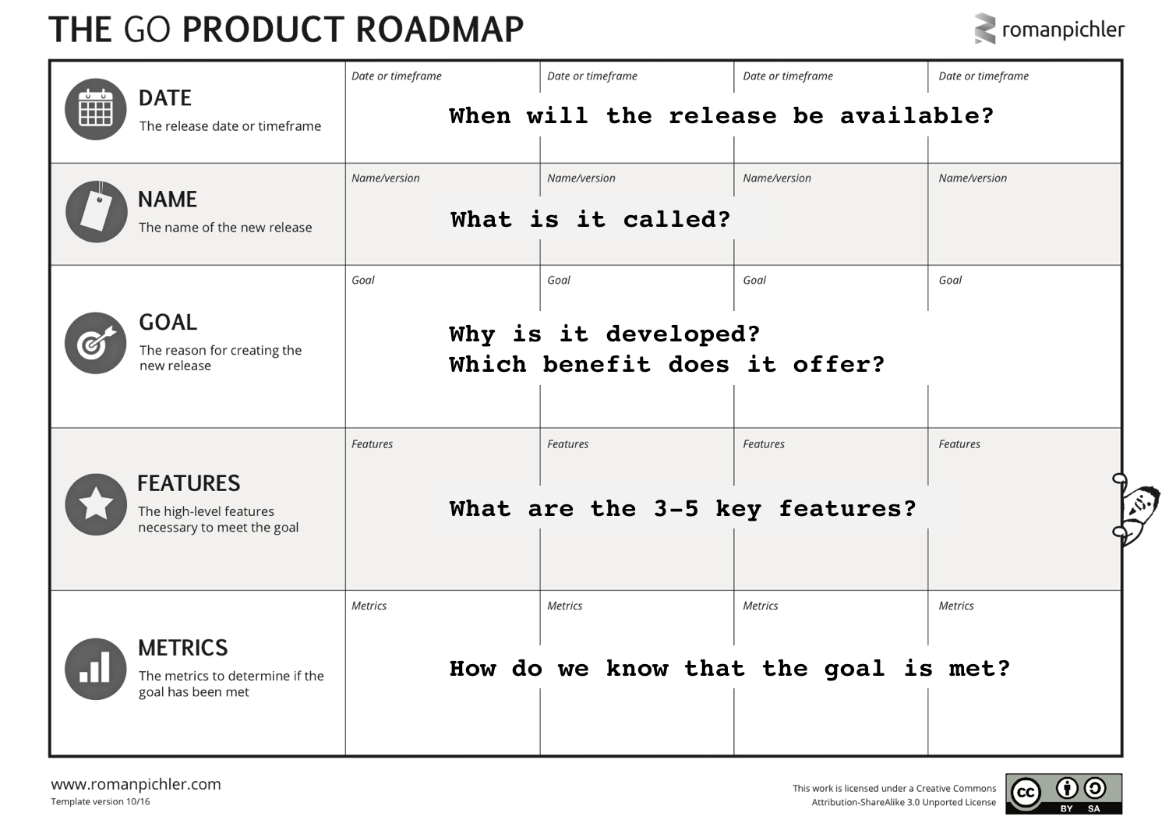
Goal Oriented Roadmap
2-9/3/24
SE ZG544 S2-23-24 Agile SW Process

Slide 51
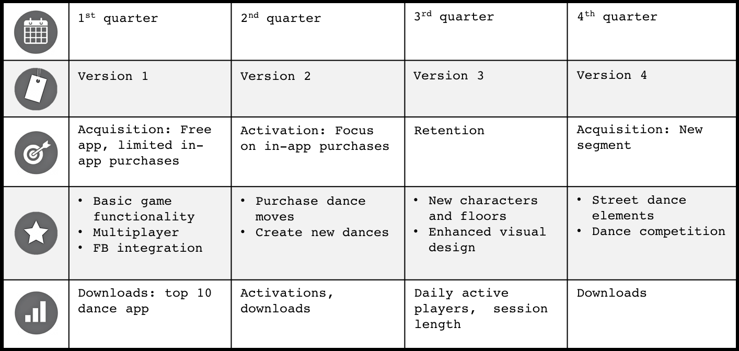
Goal Oriented Roadmap – An Example
Develop a new dance game for girls aged eight to 12 years. The app should be fun and educational allowing the players to modify the characters, change the music, dance with remote players, and choreograph new dances.
Source:https://www.romanpichler.com/blog/goal-oriented-agile-product-roadmap/
2-9/3/24
SE ZG544 S2-23-24 Agile SW Process

Slide 52
Product Backlog - Level 3
A product backlog is a prioritized list of work* for the development team that is derived from the roadmap and its requirements.
The most important items are shown at the top of the product backlog so the team knows what to deliver first.
The product backlog is the responsibility of the product owner who cares about content, availability, and priority of the backlog.
SE ZG544 S2-23-24 Agile SW Process
* List of the new features, changes to existing features, bug fixes, infrastructure changes or other activities that a team may deliver in order to achieve a specific outcome.
Source:https://www.romanpichler.com/blog/goal-oriented-agile-product-roadmap/
2-9/3/24
SE ZG544 S2-23-24 Agile SW Process

Slide 53
Characteristics of a Product Backlog
There is an abbreviation that combines similar characteristics of good product backlogs. This is DEEP:
Detailed appropriately
higher-priority items are described in more detail than lower-priority ones
Emergent
It evolves and its contents change frequently. New items emerge based on customer and user feedback and are added to the backlog. Existing items are modified, reprioritized, refined, or removed on a regular basis.
Estimated
The product backlog items–certainly the ones participating in the next major release–should be estimated. The estimates are coarse-grained and often expressed in story points or ideal days.
Prioritized
All items in the product backlog are prioritized (or ordered)
Source: https://www.romanpichler.com/blog/make-the-product-backlog-deep/ Copyright © Pichler Consulting
2-9/3/24
SE ZG544 S2-23-24 Agile SW Process

Slide 54
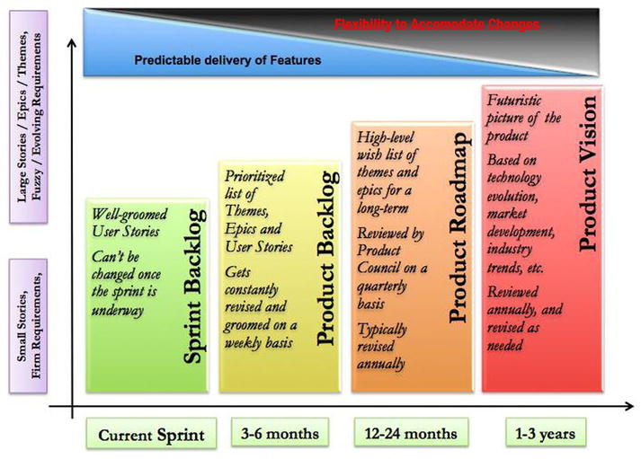
Product runways represent a healthy trade-off between flexibility and predictability
Flexibility to accommodate change
Release Backlog
Timeline vary
Ref: Agile Product Development: How to Design Innovative Products That Create Customer Value by Tathagat Varma ublished by Apress, 2015
2-9/3/24
SE ZG544 S2-23-24 Agile SW Process

Slide 55
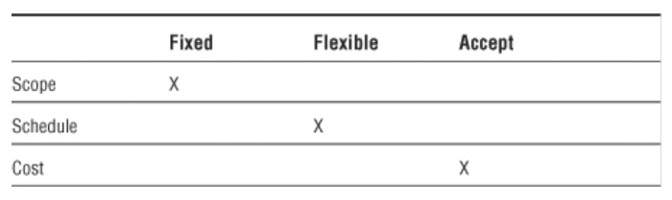
Project Trade-off Matrix
The tradeoff matrix helps the development team, the product team, and the executive stakeholders manage change during a project.
The trade-off matrix informs all participants that changes have consequences and acts as a basis for decision making.
The trade-off matrix indicates relative importance of the three constraints (scope, schedule, cost) identified on the agile triangle (value, quality, constraints).
The importance goes from Fixed, to Flexible, to Accept, the tolerance for variation increases.
Ref: Agile Project Management: Creating Innovative Products, Second Edition by Jim Highsmith Published by Addison-Wesley Professional, 2009
2-9/3/24
SE ZG544 S2-23-24 Agile SW Process

Slide 56
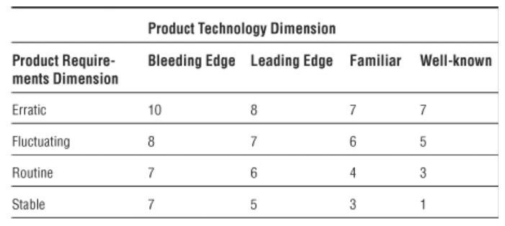
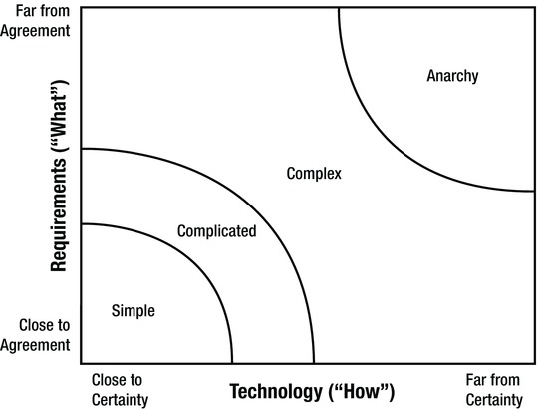
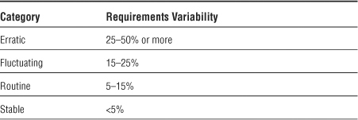
Exploration Factor
Articulating an exploration factor helps considerably in managing customer and executive expectations.
Stacey Matrix
Ref: Agile Project Management: Creating Innovative Products, Second Edition by Jim Highsmith Published by Addison-Wesley Professional, 2009
2-9/3/24
SE ZG544 S2-23-24 Agile SW Process

Slide 57
End
2-9/3/24
SE ZG544 S2-23-24 Agile SW Process

